Slide 1
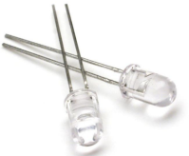
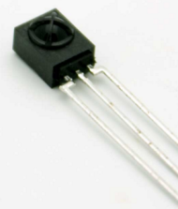
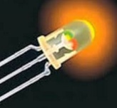
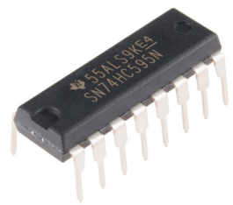
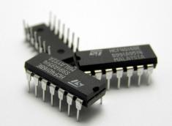

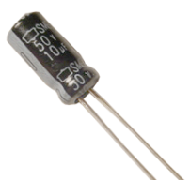
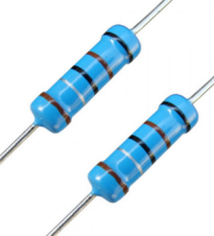
Technology Used:
IR LED and Color LED
IR Receiver
Shift Registers
Timers and Counters
Gates
Switches
Multiplexer
Capacitors and Resistors

Slide 2
Modules of System
Remote System
Reset System
Lock System

Slide 3
How Works???
7 bits sequence is used for password
Sequence passed to lock using IR emitter and sensor module

Slide 4
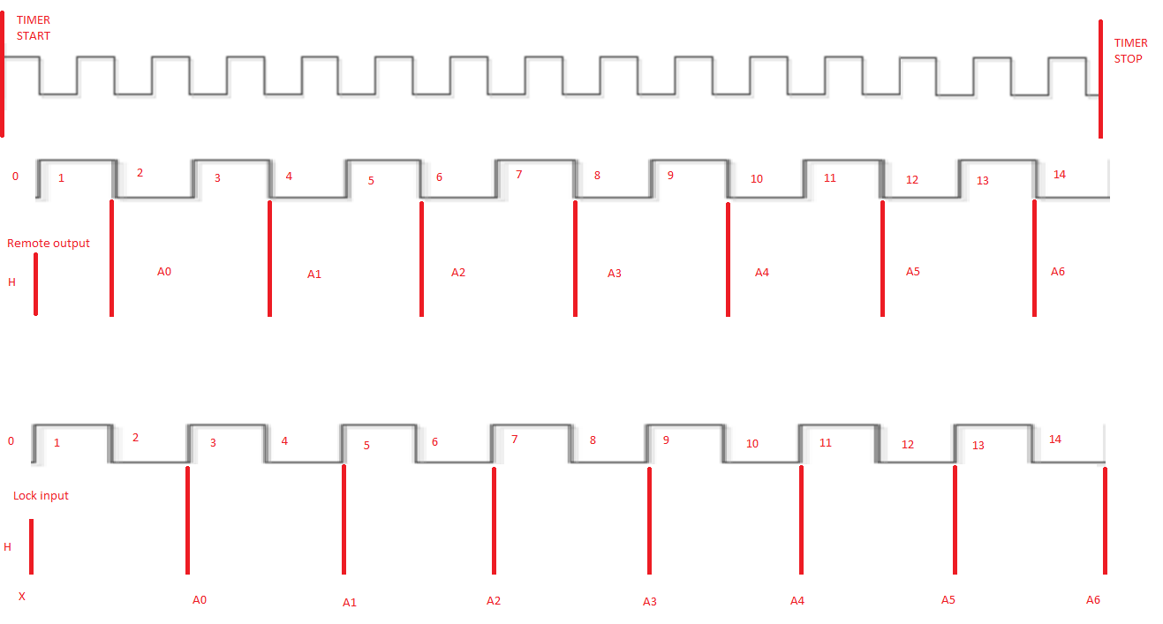
Sequence Emission and Receiving

Slide 5
Lock Working
Store Sequence is compared by input Sequence using Comparator
On equal ->open the door
On unequal ->close the door

